Slide 1
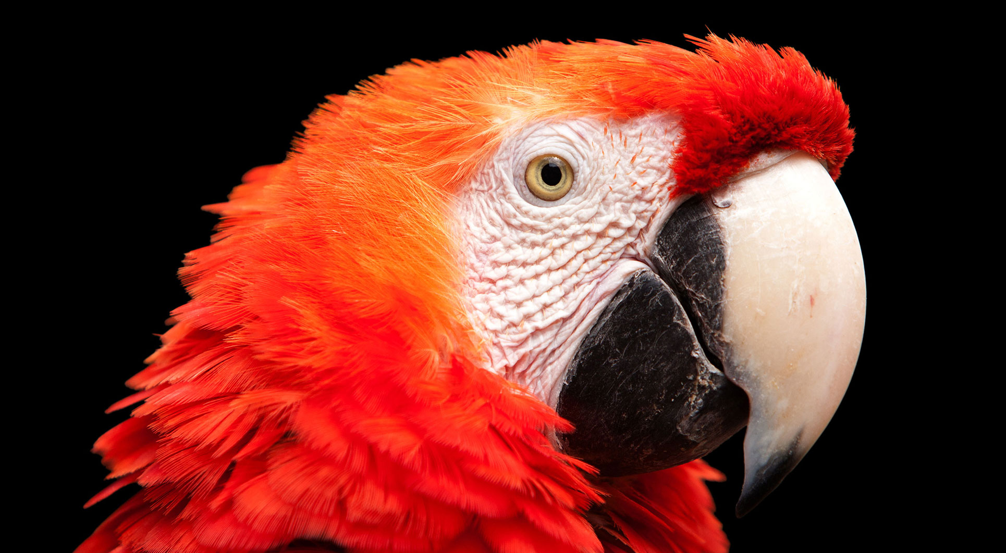
11.1 贪吃蛇 – 树莓的出现
《Python青少年趣味编程》
小牛叔出品

Slide 2
1、随机数与filter函数
1.random.choice(population) -> object
2.filter(function, iterable)

Slide 3
2、随机显示树莓位置
screenBlankGrid = [(x*30,y*30) for x in range(0,30) for y in range(0,20)]
def __init__(self, snake_line=[]):
pygame.sprite.Sprite.__init__(self)
blank_grid = list(filter(lambda x :x not in snake_line, Raspberry.screenBlankGrid))
xy = random.choice(blank_grid)
Raspberry.screenBlankGrid.remove(xy) #占用
self.rect = Rect(xy[0], xy[1], 30, 30)
self.image =pygame.image.load('snake_food.png')
Raspberry.group.add(self)

Slide 4
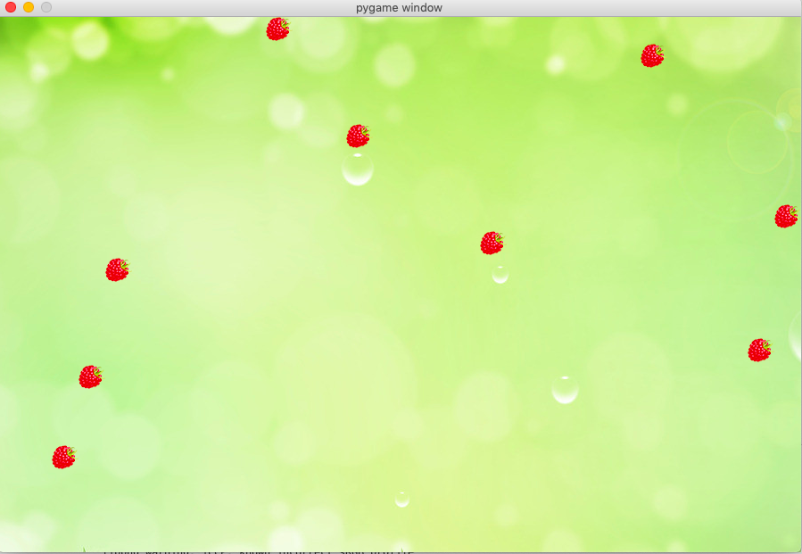
3、加入蛇的动画

Slide 5
4、主程序
pygame.init()
screen = pygame.display.set_mode((900,600))
bg = pygame.image.load('bg.jpg')
snake = Snake(screen)
clock = pygame.time.Clock()
level = 1
while True:
clock.tick(4)
KEY = None
for eventType in pygame.event.get(): # 进行事件等待
# 如果用户点击了关闭窗口按钮，那么就执行退出
if eventType.type == QUIT:
sys.exit()
elif eventType.type == KEYUP:
KEY = eventType.key
screen.blit(bg,(0,0)) #先把背景贴覆盖上，删除原图上的小蛇
snake.move(KEY)
snake.show()
if len(Raspberry.group.sprites())<level:
Raspberry(snake.snakeLine)
Raspberry.group.draw(screen)
pygame.display.update()

